Slide 1
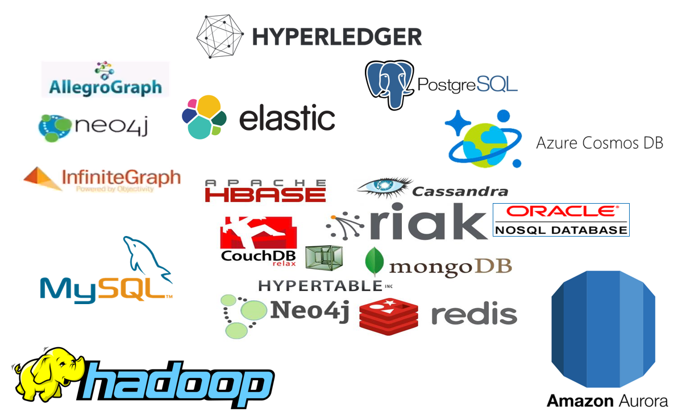



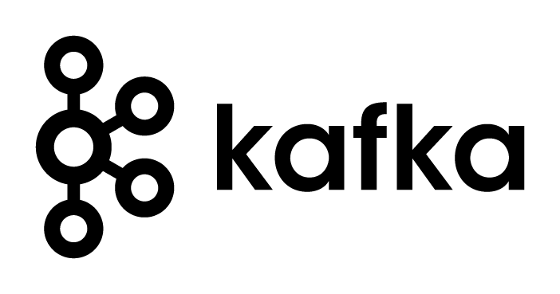



Introducing Apache Kafka – Part Two The Event Fabric tying everything together
µ
µ
Three Part Online Meetup - 20 april 2020
Lucas Jellema, CTO & Architect AMIS | Conclusion

Slide 2
Overview
What is Apache Kafka? Core concepts and technology
Lab 1 – First hands-on with Apache Kafka
Programming
Brief introduction of Node (JS)
Lab 2 – Programmatic interaction with Apache Kafka
The Eneco Case – The Event Streaming Platform
Shades of Data – Streaming, CQRS, Event Sourcing
Lab 3 – DIY CQRS
Microservices and the quest for decoupling
Lab 4 – Microservices Interaction and Choreography
But wait – there is more:
Ecosystem and supporting tools
Alternative offerings (public cloud and stand-alone)
Part One
Part Two
Part Three

Slide 3

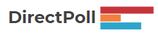
http://etc.ch/QmfH

Slide 4
Events == Messages
Consumers
Producers
Robust, Scalable, Fast, History Retention
Containerized/Cloud-enabled
Open

Slide 5


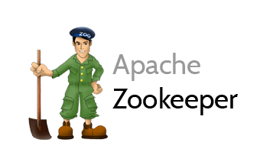
Cluster
Consumers
tcp
Producers
tcp
Broker
Topic
Partition
Consumer Group
Partition Log
Replica

Slide 6
What’s so special?
Durable transactions
Scalable
High volume
High speed
Available
Distributed
Open
Quick start
Free (no license costs)
“Self Fulfilling Prophecy” (positive feedback loop feeding from buzz around Kafka)
Eco system, tools/libraries/resources, cloud services

Slide 7
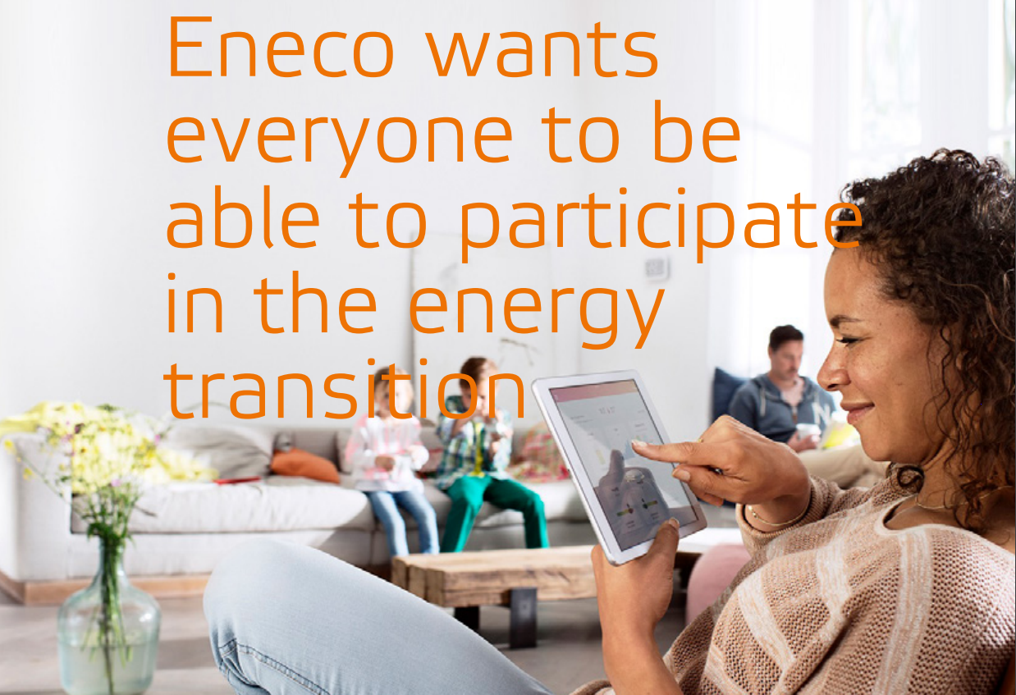
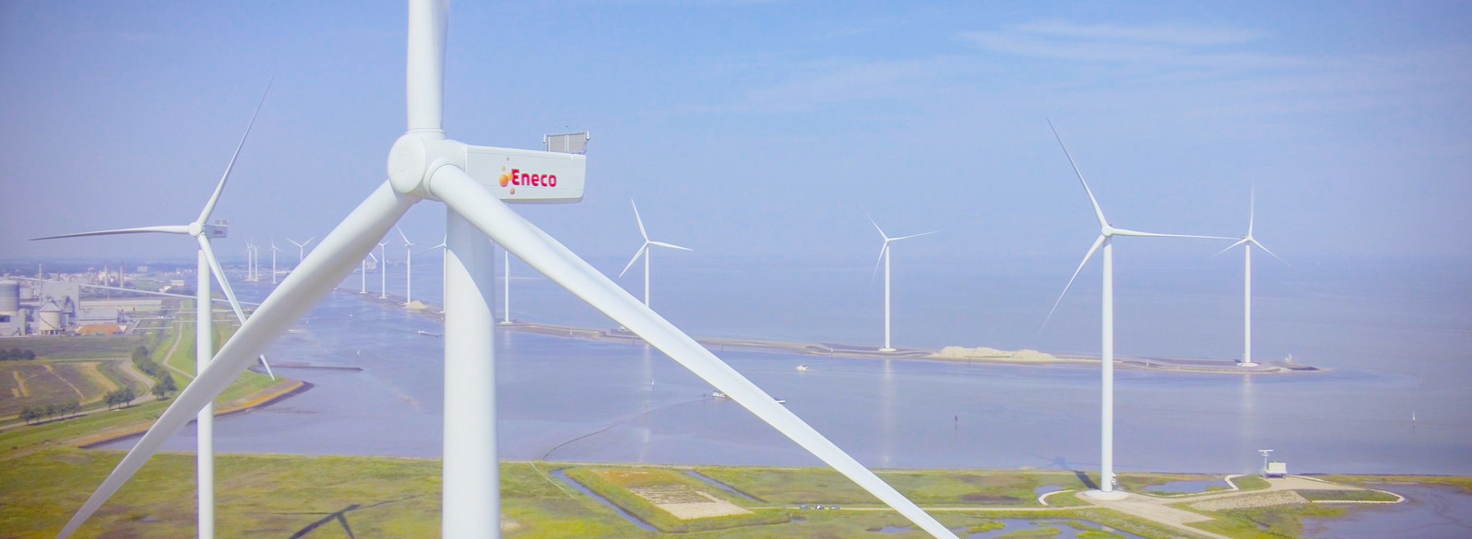
Eneco – Utility company
Interesting mix of operational, real time systems in physical environments, large scale enterprise systems for 1000s of internal professionals and millions of external consumers – with a mission to improve the world

Slide 8









Utility Company looking for Performance, Scalability and Availability in their core data sets
Marketing Campaigns
Invoicing
CRM
Billing
batch
Meter Readings
Load on Core Systems & effect on Performance
Availability Core Systems

Slide 9
Utility Company looking for Performance, Scalability and Availability in their core data sets
Marketing Campaigns
CRM
Invoicing
CRM Cache DB
Meter Readings
Billing
Meter Readings Cache DB

Slide 10
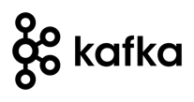
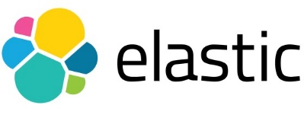

Utility Company looking for Performance, Scalability and Availability in their core data sets
Marketing Campaigns
CRM
Invoicing
CRM Cache DB
Meter Readings
Billing
Meter Readings Cache DB

Slide 11
Practical Challenges
Marketing Campaigns
Publish all [fine grained] change events from sources
Event schema evolution
Lag in Cache Databases
“eventual consistency”
Differences between sources and cache databases
Initial creation of Cache Databases
General Scale and Incidental event storm
Business and Mission Critical availability
Data Authorization
Logic enforced in source (applications)
GDPR
CRM
Invoicing
CRM Cache DB
Meter Readings
Billing
Meter Readings Cache DB

Slide 12

Apache Kafka platform at Eneco is enclosed in Axual Platform - managed by Conclusion Mission Critical
CRM
CRM Cache DB
Meter Readings
Meter Readings Cache DB

Slide 13
CQRS

Slide 14
CQRS
Products
Data Manipulation
Data Retrieval

Slide 15

Same Data, Multiple – different – Usage Scenarios
Different in:
Why
What – grain, aggregation, breadth, type of and variation in queries
How – format, language, accuracy and freshness, consistency
When – frequency, time of day | week | month, 24/7
Where – latency, band width, off line
Who – scale, different roles & user groups

Slide 16
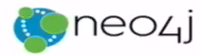




CQRS: Command Query Responsibility Segregation
Products
Data Manipulation
Quick Product Search Index
Special Products
Data Retrieval
Toys
Product Clusters
Product Store in SaaS app
Food Stuff
Notes:
Data manipulation and retrieval in separate places
(physical data proliferation)
Query store is optimized for consumers
Level of detail, format, filters applied
For performance and scalability, independence, productivity lower license fees and lower TCO, security

Slide 17
CQRS Steps and Challenges
Spot and Handle Errors
Governance & Evolution
Detect changes
Products
Extract Data
Enforce Constraints & Authorization
Data Manipulation
Transport Data
Convert Data
Special Products
Apply Data
Data Retrieval
Toys
Quick Product Search Index
Product Clusters
Food Stuff
Product Store in SaaS app
Notes:
No Event Sourcing
No events (?)
No green field
Packages Applications/SaaS
Databases (RDBMS, NoSQL) getting changes from applications directly
Challenges – at scale, with enough speed and consistently: do not let query store get into an exposed state that could not exist/be right!
Detect relevant changes
Extract relevant changes
Transport
Convert
Apply in correct order and reliably (no lost events)
Note: after detect and extract, an event can be published

Slide 18


From C to Q
How quickly?
How frequently?
How reliably?
How atomically?
Products
Quick Product Search Index

Slide 19
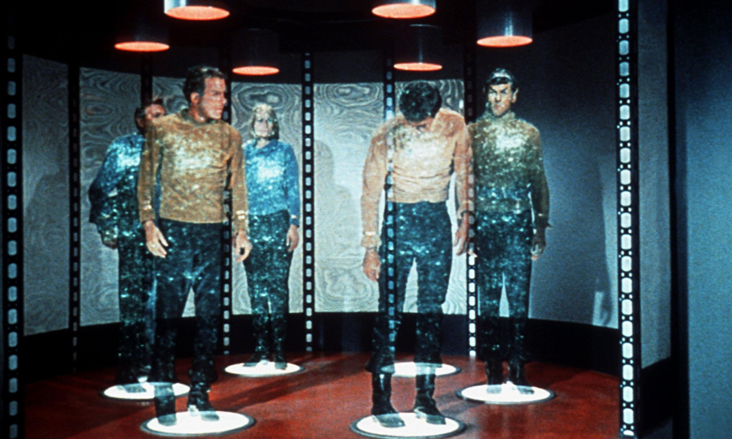

Slide 20
From C to Q
How quickly?
How frequently?
How reliably?
How atomic?
Data Authorization Considerations
Locations & Connectivity
Full resynch | restore of Query Store
Products
Quick Product Search Index

Slide 21
Typical CQRS Architecture
Source systems
Change Reporters
Distributed Change Event Hub
Change Projectors
Destination systems
Transform & Apply
Poll
Event Platform
Detect & Retrieve Change
(re)Calculate & Record
Consume
Convert, Translate, Store
Event Schema Governance
Monitoring & Error Handling
Notes:
Destination system: can be cache, or even only the programmatic representation – without any data duplication
Dumb pipes, smart end points

Slide 22
Technologies to support CQRS
Detecting and Extracting and Publishing Changes
Database specific change detection
Debezium, Kafka Connect, Oracle SOA Suite Inbound Adapters,
Cloud Adapters in iPaaS platforms and SaaS products
Decoupled gathering & queueing of change events (preferably distributed and technology agnostic; options for long term event retention)
Apache Kafka,
Rabbit MQ, AWS SQS, JMS, Azure Event Hub, Active MQ, …
Handling change – transport, transform, apply
Query Stores – picked based on data use case requirement, not specifically for CQRS
Any database, in memory cache
Apache Cassandra, MongoDB, Elastic Stack, Redis Cache, MySQL, …

Slide 23
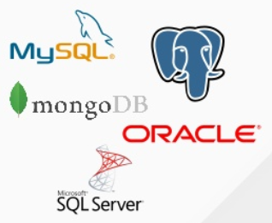

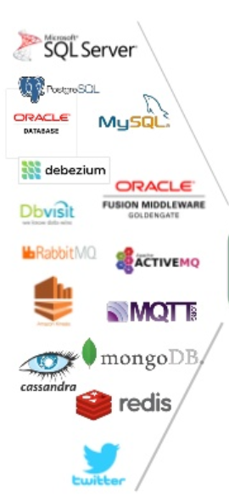
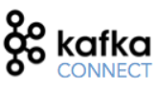

Detecting and Extracting and Publishing Changes from many sources – Debezium, Kafka Connect, Apache Kafka
CDC
Debezium
Apache Kafka
Notes:
MySQL: binlog; Postgres: wnte-ahead log; MongoDB op log

Slide 24
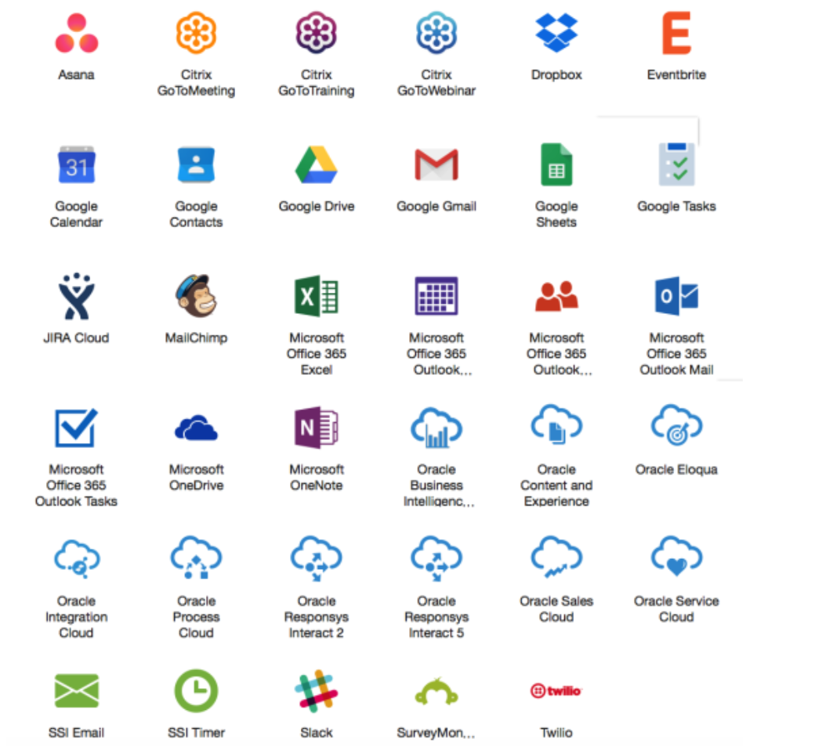
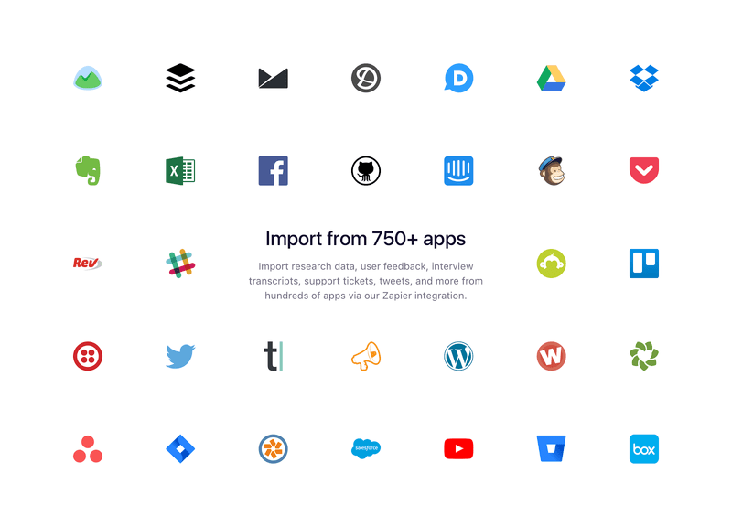
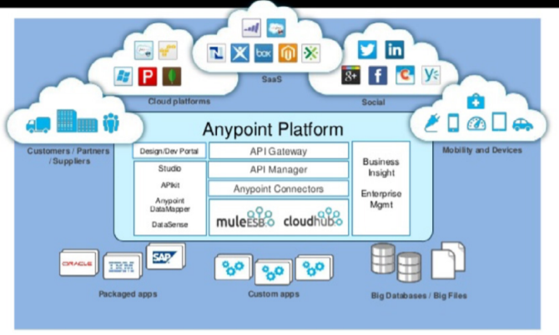
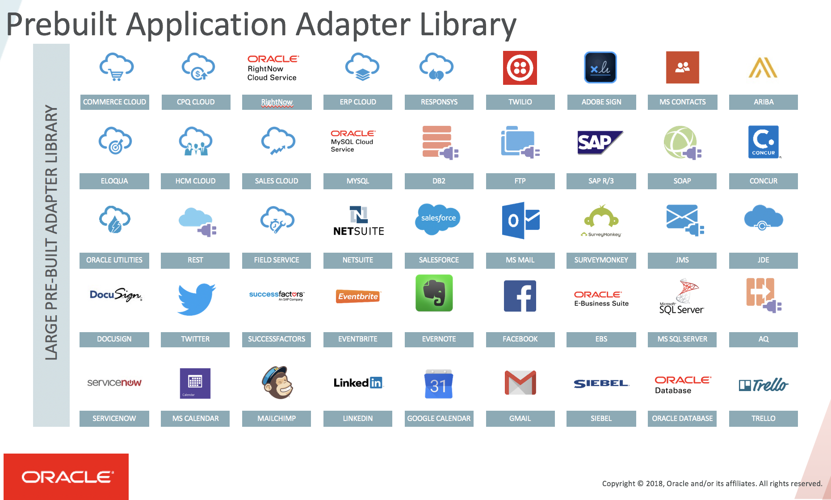
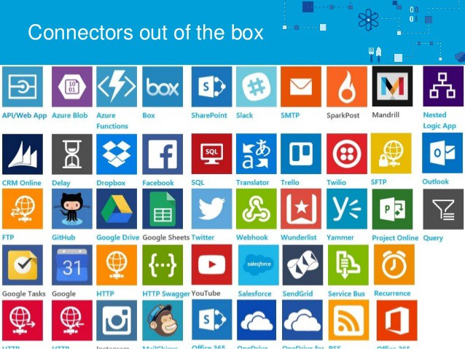
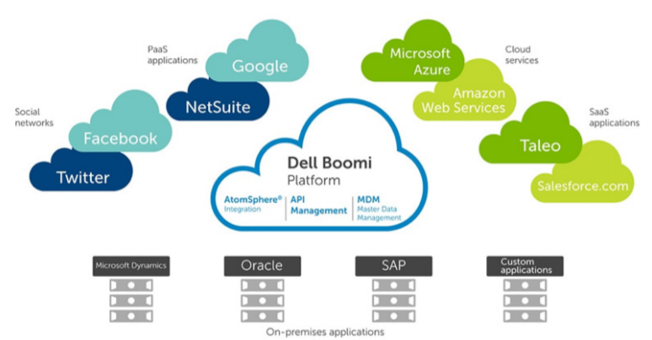
iPaaS (Cloud) Adapters for SaaS & Platform
Prepackaged Change Event Detectors
Notes:
AnyPoint
Zapier
SSI
OIC
Dell Boomi

Slide 25
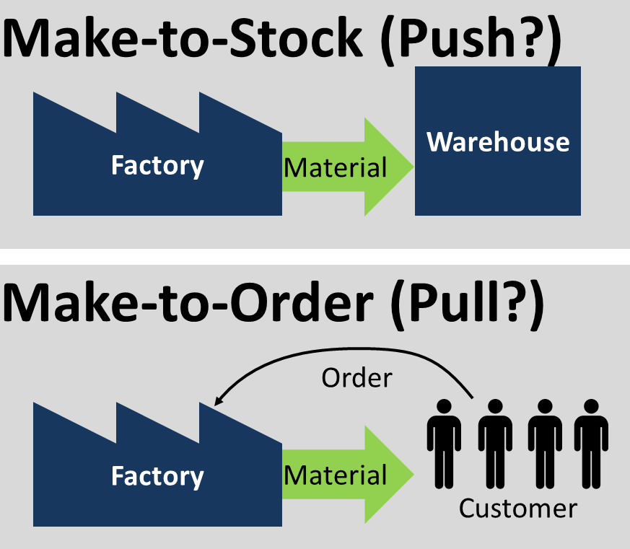
JIT vs AOT
CQRS
Truth
Failure
SPo

Slide 26
JIT vs AOT Data Integration
Just In Time
Process [synchronous] request for data ‘just in in time’
Only data that is requested
Fresh as can be
All authorization rules applied
Single Source of Truth and of Failure
Transformation & Aggregation at request time
Hard (runtime) dependencies from consumer on producer
Ahead Of Time (CQRS)
Pre-process / pre-share data ‘ahead of time’
Potentially includes data that will never be requested
Data can be outdated
Data is ready to go (easy and quick to get) and tailor made for use case

Slide 27
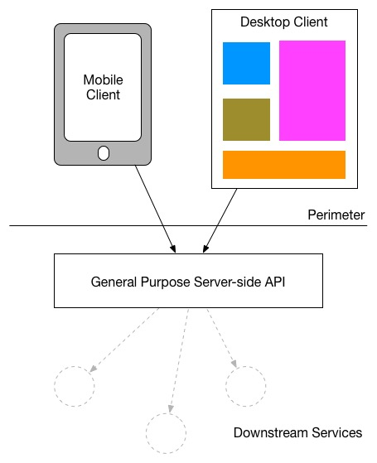
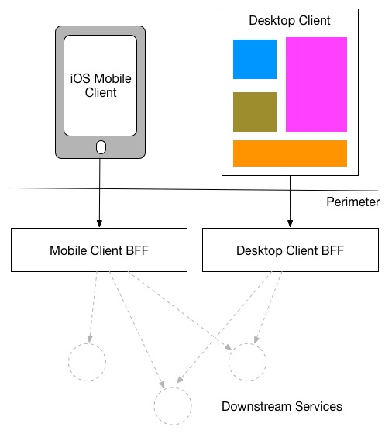
Backend For Frontend

Slide 28

CQRS => Data Backend For Frontend: Optimized data set for special use case
Shape & Format
Right Grained (aggregation, consolidation)
Filtered
Enriched (from multiple sources)
Location
Time (refreshed at the right time)
Search Options
BASE (eventually – when? – consistent)
Authorization
GDPR
UI
APIs
(backend for frontend)
Data Store
Master Database

Slide 29
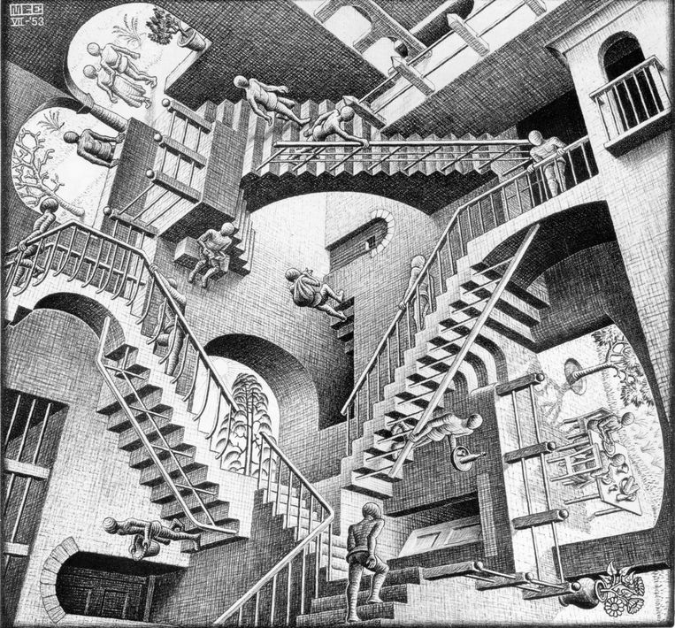
CQRS: A small step for mankind but a giant leap for [IT] architects

Slide 30
Event Sourcing

Slide 31
Utility Company: Rebuild Cache Database
CRM
CRM Cache DB
Meter Readings
Meter Readings Cache DB

Slide 32
Utility Company: Rebuild Cache Database From Event Store
CRM Cache DB
Meter Readings Cache DB

Slide 33
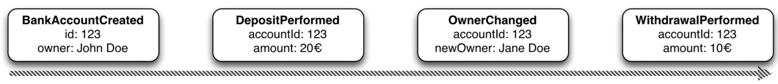
Event Sourcing Driving CQRS
amount: 10
Owner: Jane Doe
Events
Current State
Event Store
accountId: 123
Notes:
Events are immutable facts
Current state (active record) is derived from sum of events
Read optimized aggregates are created for specific use case – based on events and rebuildable at any time

Slide 34
Event Sourcing Driving CQRS
Events
Current State
Event Store
Other State Aggregate
Notes:
Events are immutable facts
Current state (active record) is derived from sum of events
Read optimized aggregates are created for specific use case – based on events and rebuildable at any time

Slide 35
Event Sourcing
Event Store is immutable – append-only log of domain state transitions
It is the truth about data – everything else is derived
Replay events
to (re)construct a representation of the current state (aggregate)
up to a specific time to recreate moments in time
in Test environment to investigate an issue
on a remote location to create mirror & share state across boundaries
produce a fine grained audit trail
Challenges
Time required to reconstruct state
Grain of aggregates / definition of domain events

Slide 36
http://etc.ch/QmfH

Slide 37
Overview
What is Apache Kafka? Core concepts and technology
Lab 1 – First hands-on with Apache Kafka
Programming
Brief introduction of Node (JS)
Lab 2 – Programmatic interaction with Apache Kafka
The Eneco Case – The Event Streaming Platform
Shades of Data – Streaming, CQRS, Event Sourcing
Lab 2b and Lab 3 – DIY CQRS
Microservices and the quest for decoupling
Lab 4 – Microservices Interaction and Choreography
But wait – there is more:
Ecosystem and supporting tools
Alternative offerings (public cloud and stand-alone)
Part One
Part Two
Part Three

Slide 38
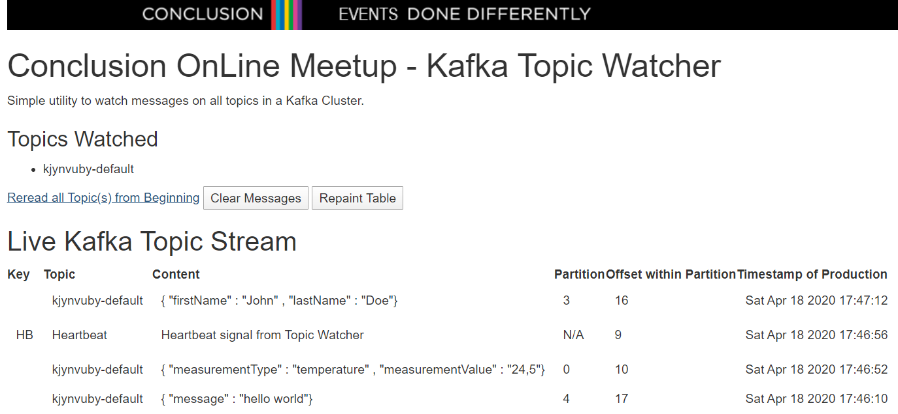
Lab 2b – The Kafka Topic Watcher
Live Messages Monitor on all Topics in a Kafka Cluster
new and historic, streamed from Topic all the way to the browser

Slide 39


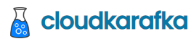


Lab 2b – Solution Design for Kafka Topic Watcher
Every event consumed from a Kafka Topic is pushed to the browser as Server Sent Event
Kafka Topic Watcher
Node application runs HTTP Server and subscribes to all topics in the configured Kafka Cluster

Slide 40
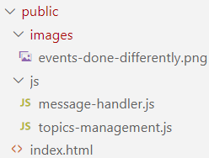
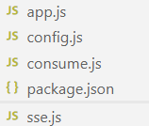
message-handler.js
index.html
topics-management.js
/updates
/config
/topics
app.js
handleMessage
sse.js
consume.js
config.js

Slide 41
Lab 3 – DIY CQRS
Handles new and changed customer details – including Mandate Setting for Connection Identifier
REST API Call to POST/PUT or GET customer details including Mandate
REST API Call to GET Mandate Setting
Publish Event to Kafka Topic for every new or changed Mandate Setting
CRM
IoT Platform
Need to have the SmartMeter Mandate Setting for every ConnectionId for
Consume Event and Record new Mandate Setting for Connection Identifier
csv

Slide 42
Lab 3 Bonus – Distributed DIY CQRS
REST API Call to POST/PUT or GET customer details including Mandate
REST API Call to GET Mandate Setting
CRM
IoT Platform
> 1,5 meter
Need to have the SmartMeter Mandate Setting for every ConnectionId for
csv
Laptop Piet
Laptop Sandra

Slide 43
Overview – Next Wednesday: Part Three
What is Apache Kafka? Core concepts and technology
Lab 1 – First hands-on with Apache Kafka
Programming
Brief introduction of Node (JS)
Lab 2 – Programmatic interaction with Apache Kafka
The Eneco Case – The Event Streaming Platform
Shades of Data – Streaming, CQRS, Event Sourcing
Lab 3 – DIY CQRS
Microservices and the quest for decoupling
Lab 4 – Microservices Interaction and Choreography
But wait – there is more:
Ecosystem and supporting tools
Alternative offerings (public cloud and stand-alone)
Part One
Part Two
Part Three

Slide 44


Thank you for your attention I hope this was useful
lucas.jellema@amis.nl | technology.amis.nl | @lucasjellema | lucas-jellema

